Slide 1
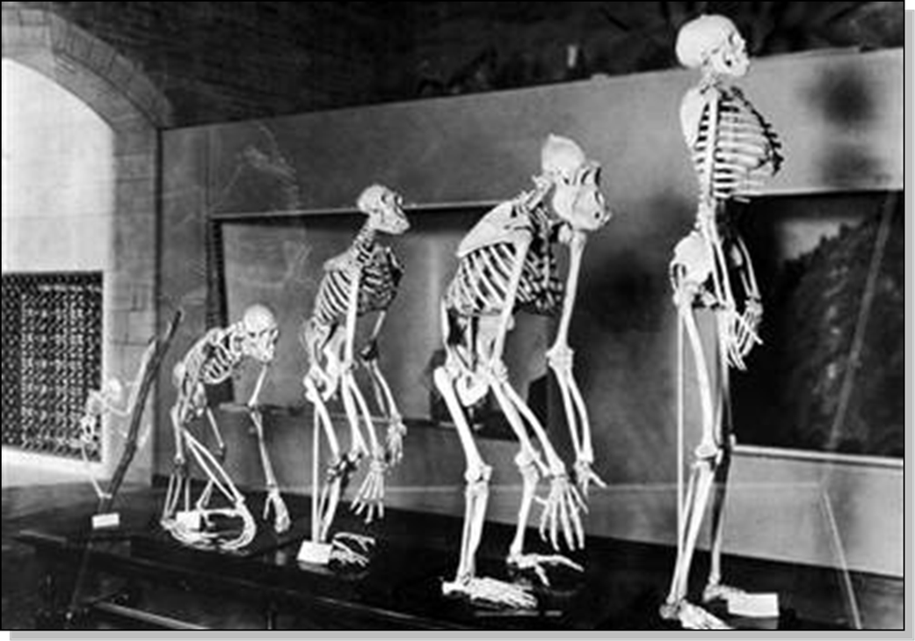
Lecture 20
Chemical Engineering for Micro/Nano Fabrication

Slide 2

Exam II
When: 9:30- 11 AM Thursday Nov. 15th
Where: FNT 1.206A
What: Lectures through 11/14/2018
Bring: Pencil and eraser
Do: Study notes, review quizes and ask questions…work with a friend??

Slide 3
Photochemistry Counts Photons
Starting Material + Photon Product
Energy/Photon, E = hv = hc/
As Wavelength Decreases, Energy/Photon Increases
Fewer photons are available for a given exposure
measured in millijoules/area
Mercury lamp produces far less Energy in the
Deep UV
Throughput Therefore Requires
-- Brighter Light Bulbs
-- More Sensitive Resists

Slide 4
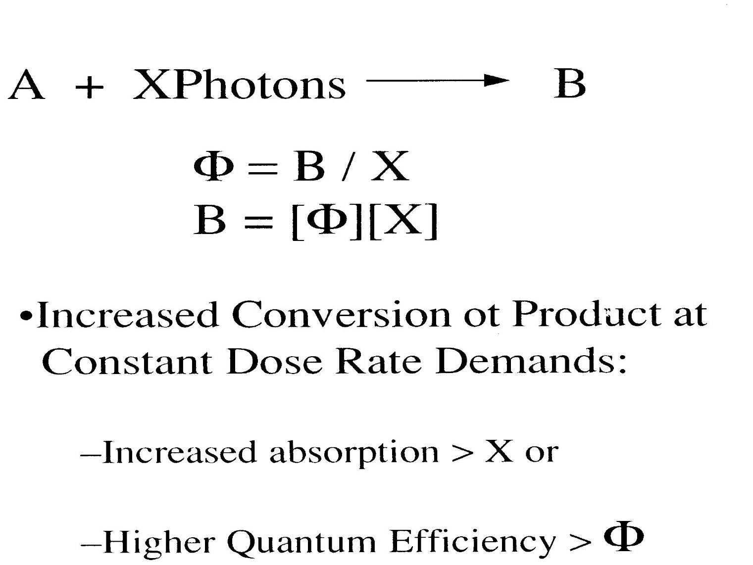
Control of Resist Sensitivity

Slide 5
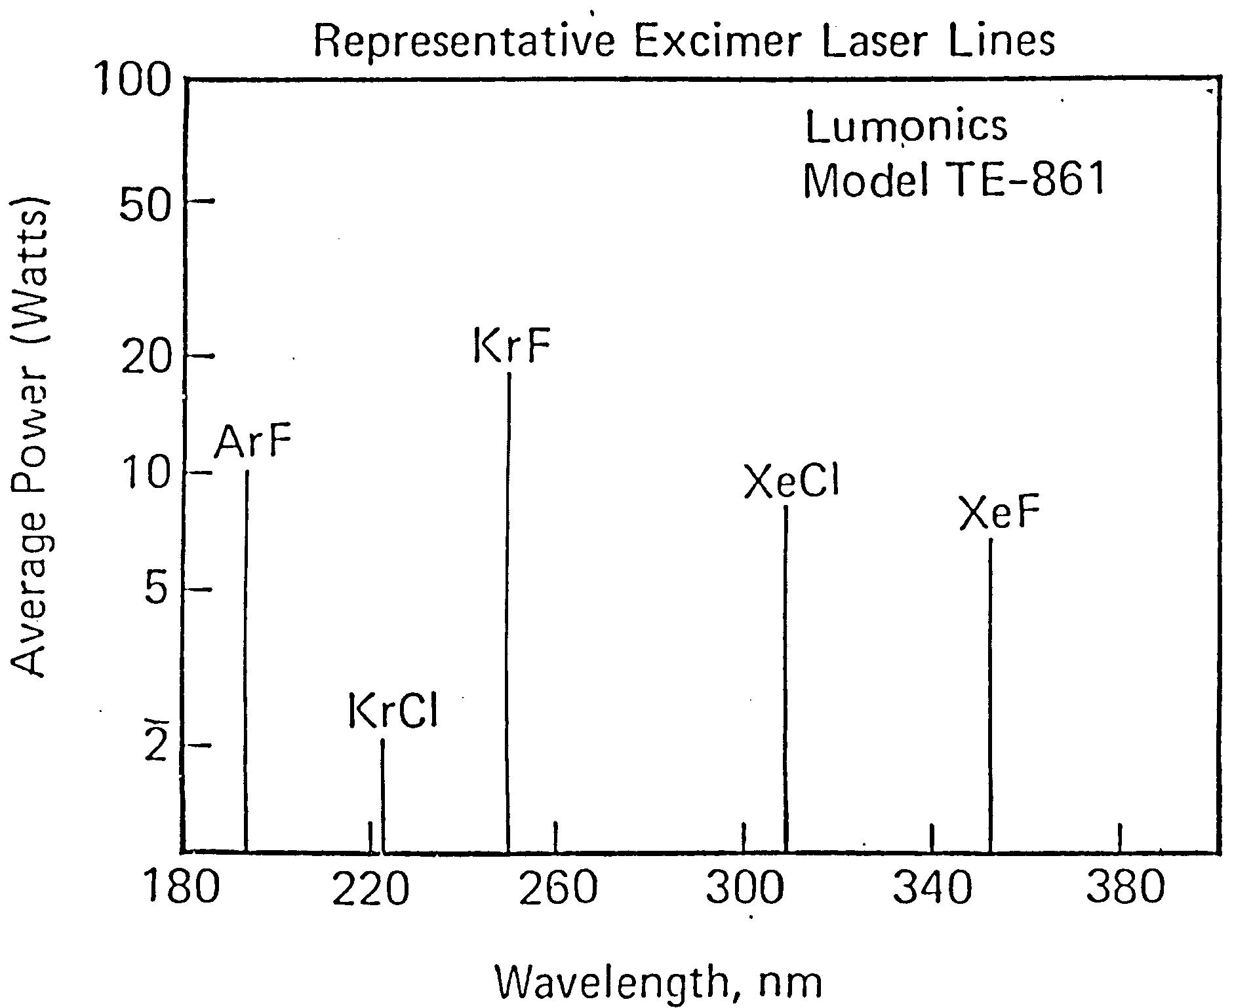
Excimer Lasers are very bright “lights”

Slide 6
Excimer / Exciplex Lasers
Noble gases do not usually form chemical compounds. However, when in an excited state (induced by electrical discharge), they can form temporarily bound molecules with themselves (excimer) or with halogens (exciplex) such as fluorine and chlorine. The excited compound can release its excess energy by undergoing emission, resulting in a strongly repulsive ground state molecule which very quickly dissociates back into two unbound atoms.

Slide 7
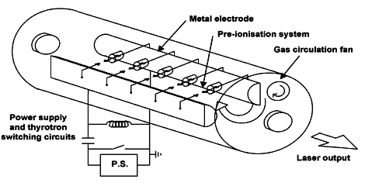
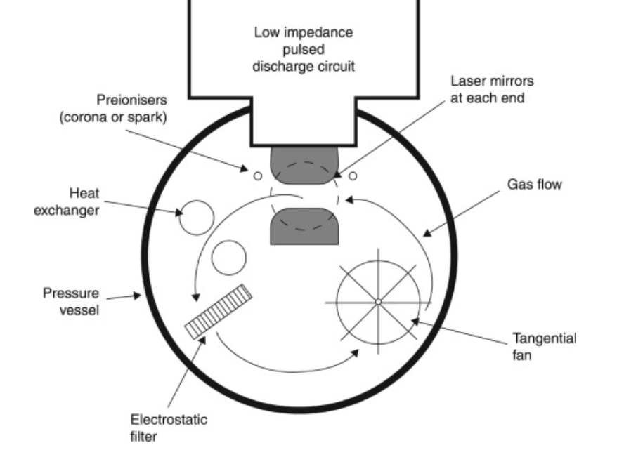

Slide 8
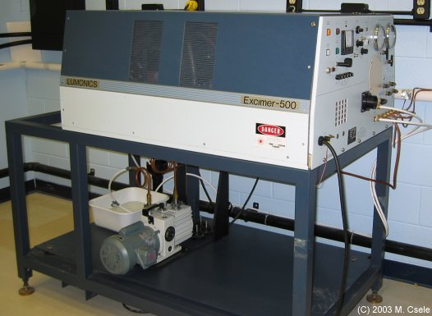
An Excimer Laser

Slide 9
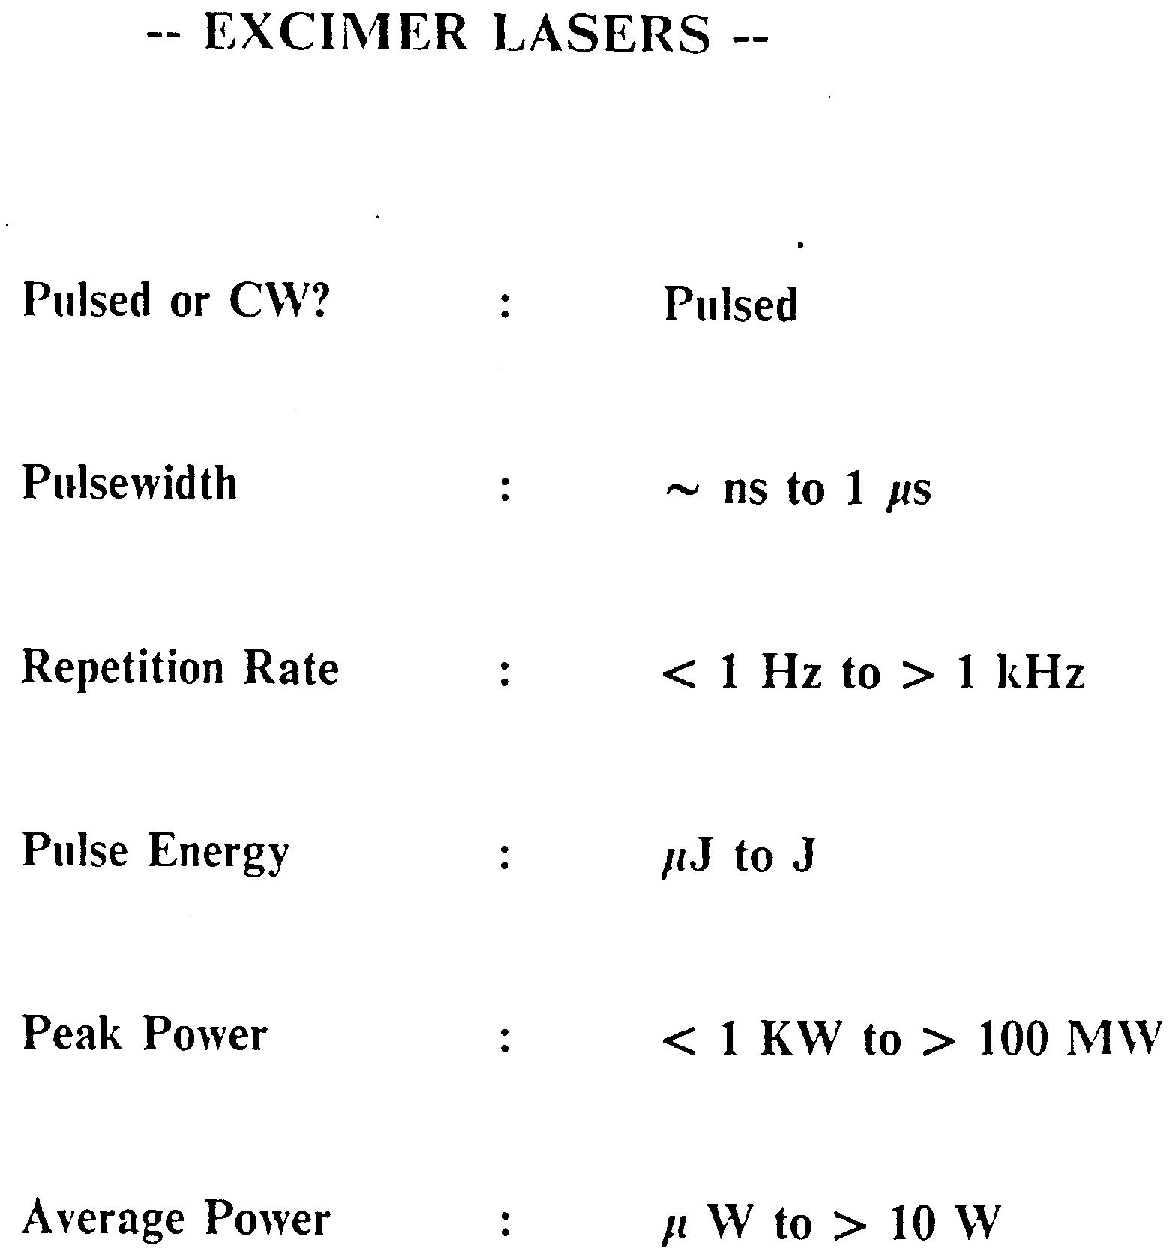
Excimer Lasers

Slide 10
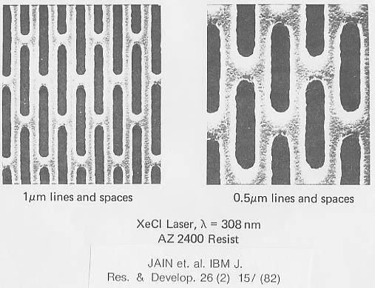
First Excimer Laser Lithography Experiment
Reciprocity proof!!

Slide 11
Chemical Amplification
Insoluble
hν
Soluble
Φ < 1
Generator
hν
Φ < 1
Catalyst
Insoluble
Soluble + Catalyst

Slide 12
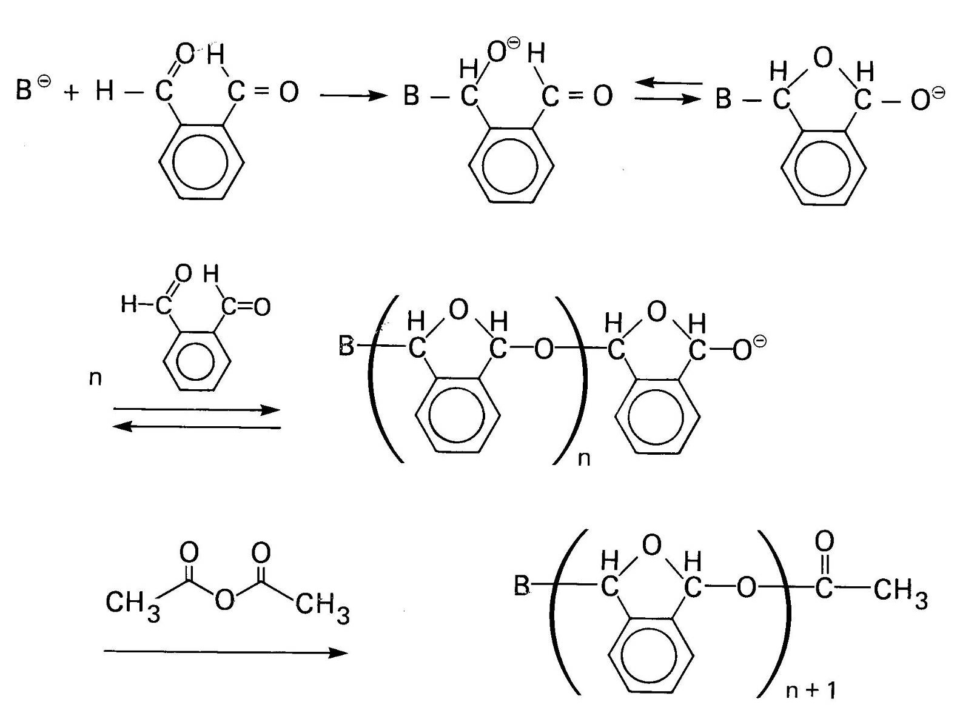
Anionic polymerization of Phthalaldehyde

Slide 13
Ceiling Temperature, T_{c}
For reversible polymerizations, there is a temperature where the position of the monomer / polymer concentration is at equilibrium, where ΔG = 0.
at equilibrium ΔG = 0 = ΔH - T ΔS
or, the Ceiling Temperture, T_{c} = ΔH / ΔS
T_{c} °C
α-methylstyrene | 66
styrene | 395

Slide 14
Photoacid Generation Mechanism
of Aryl Sulfonium Salts
Dektar, J. L.; Hacker, N. P. J. Am. Chem. Soc. 1990, 112, 6004.

Slide 15
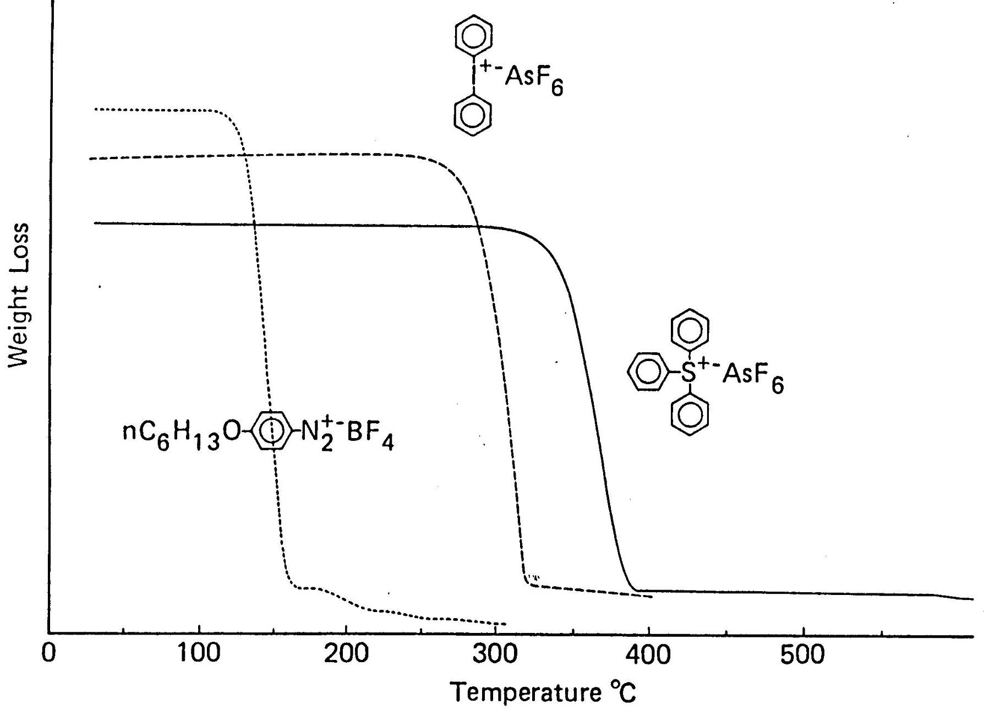
Thermogravimetric analysis of PAGs

Slide 16
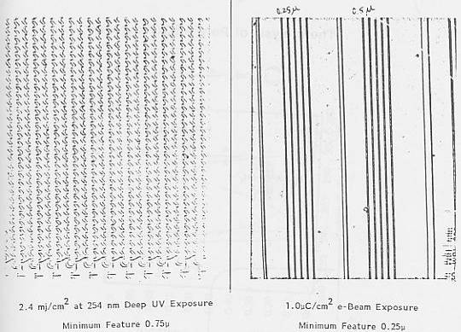
Optical Micrographs of “self-developed” Images in Polyphthalaldehyde

Slide 17
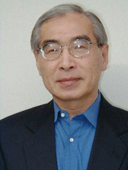
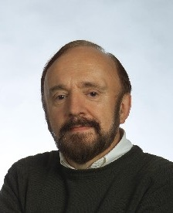
Chemically Amplified Deep UV Resists
Photoacid Generation
with
acid
without
acid
hν
Mass
S⁺⁻SbF₆
H⁺⁻SbF₆
Acid-Catalyzed Deprotection
100
150
200
250
300
Temperature (°C)
CH₂
CH
CH₂
CH
n
n
H⁺
+
CO₂
Δ
OH
O
O
+
H⁺
+
CH₂=C
CH₃
protecting
group
O
CH₃

Slide 18
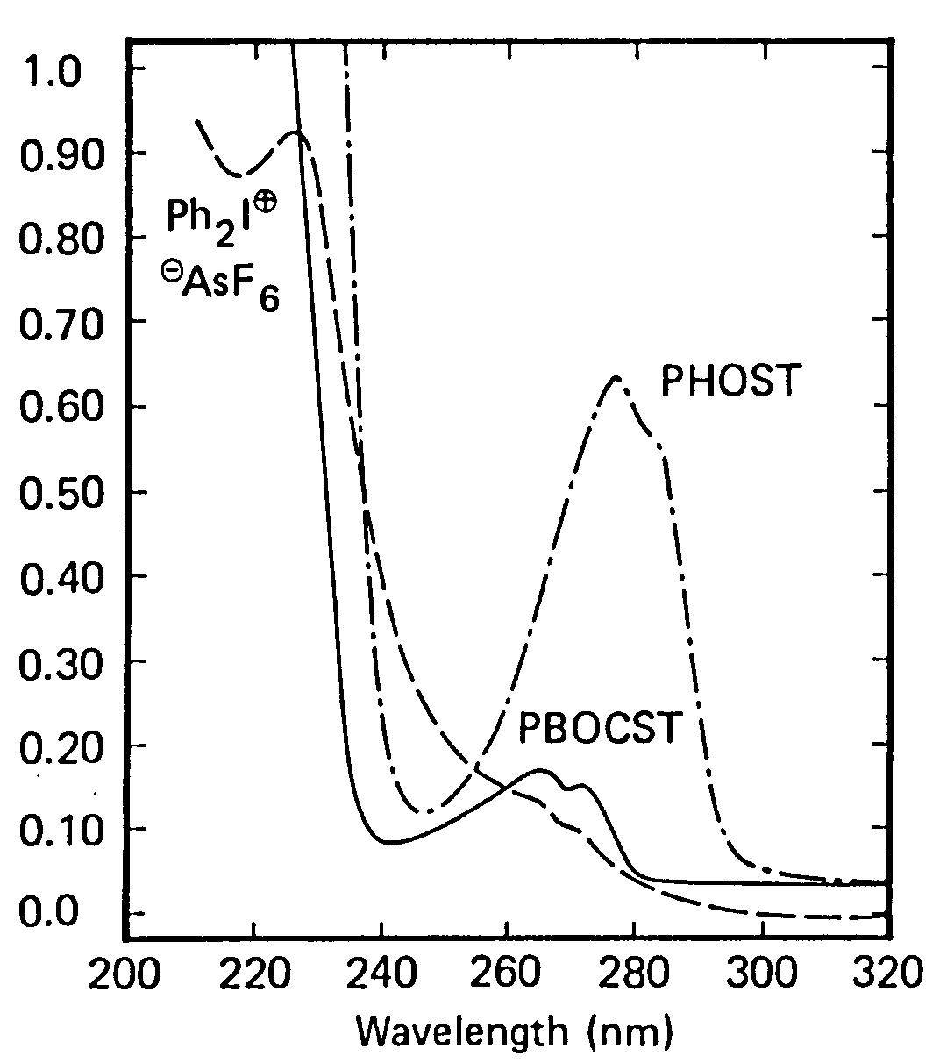
Absorbance

Slide 19
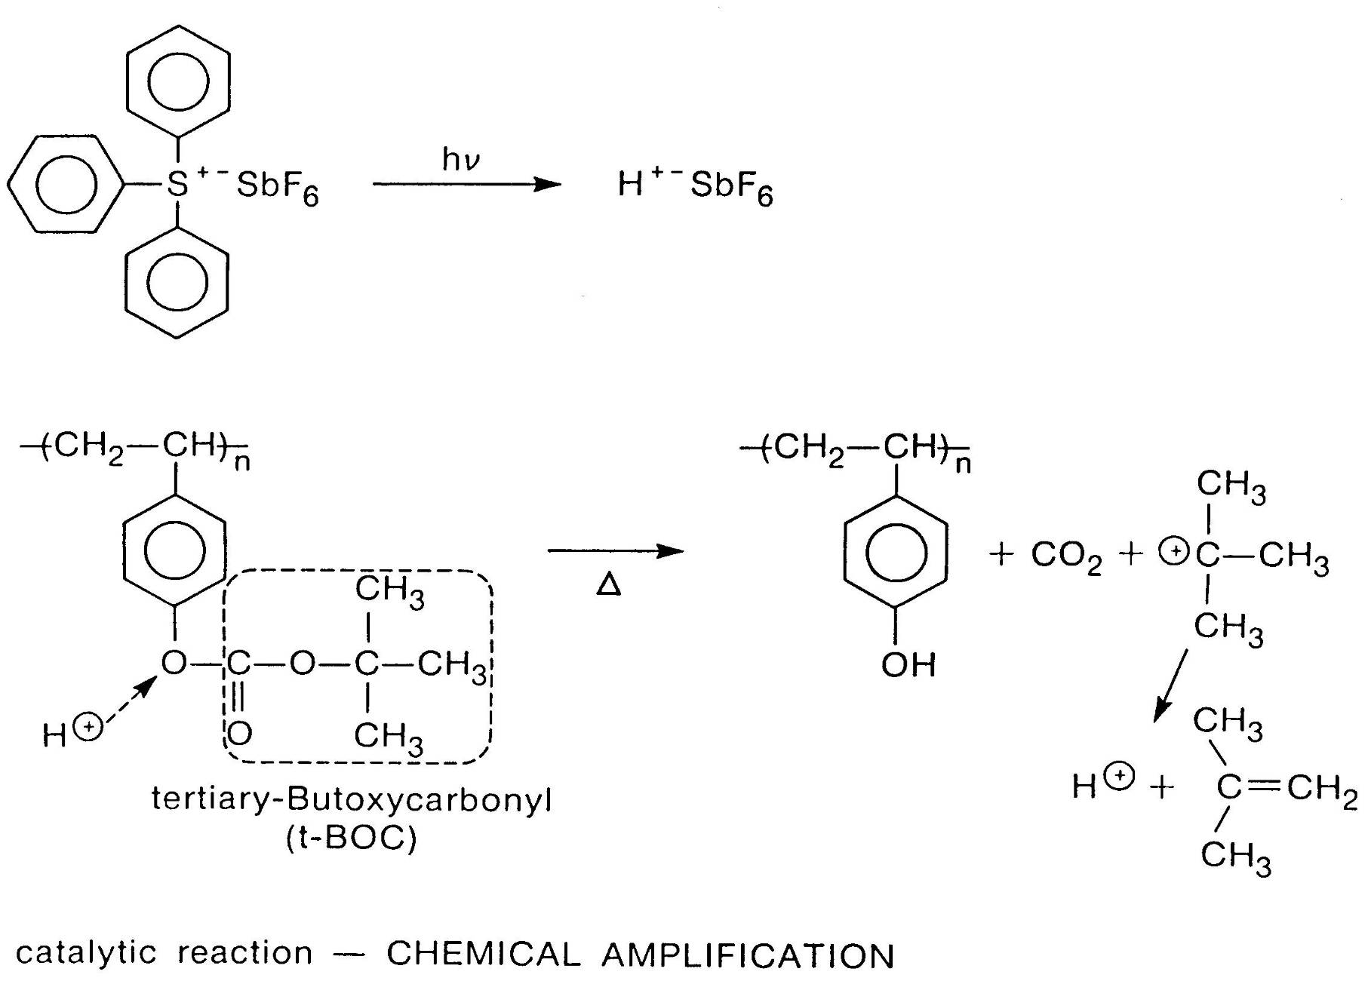

Slide 20
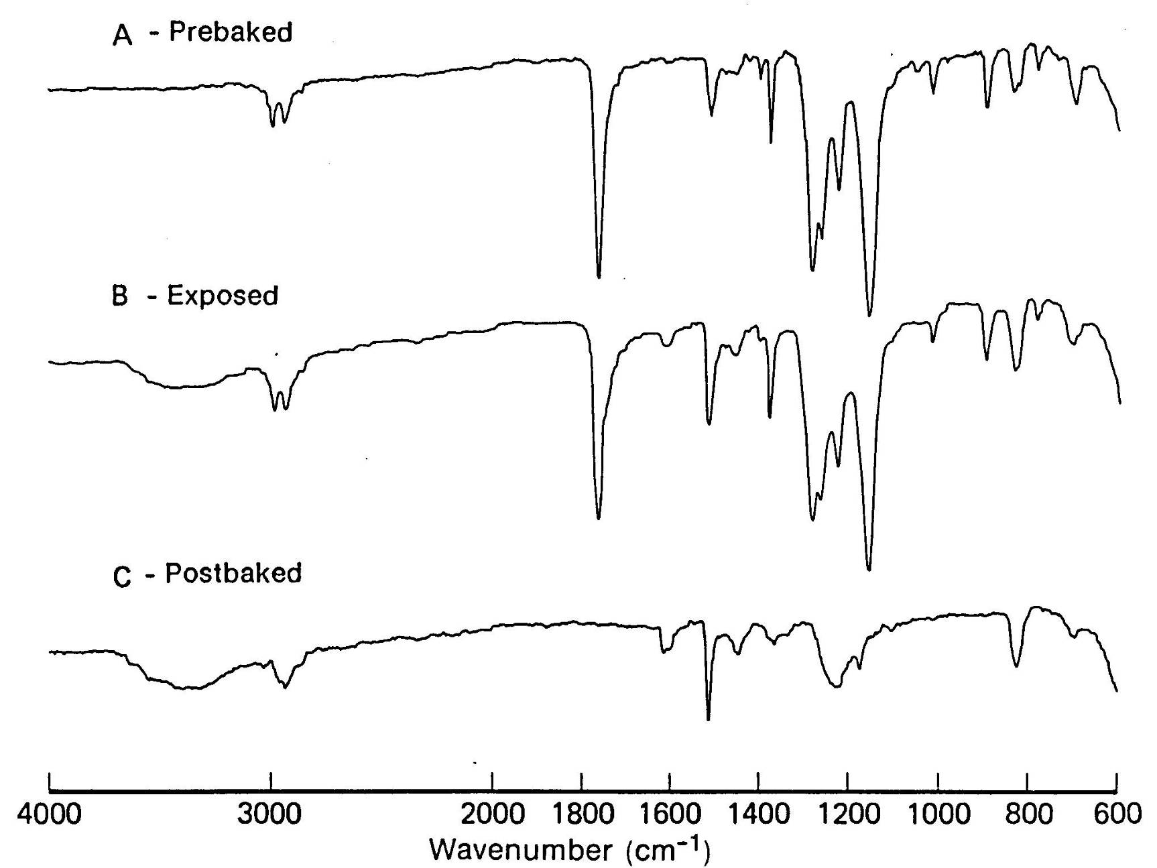
Infrared analysis

Slide 21
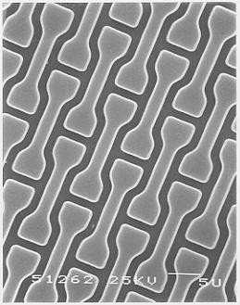
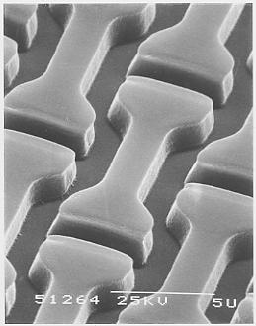
First Commercial Implementation of Deep UV Photolithography
ROX level of 1M DRAM IBM

Slide 22
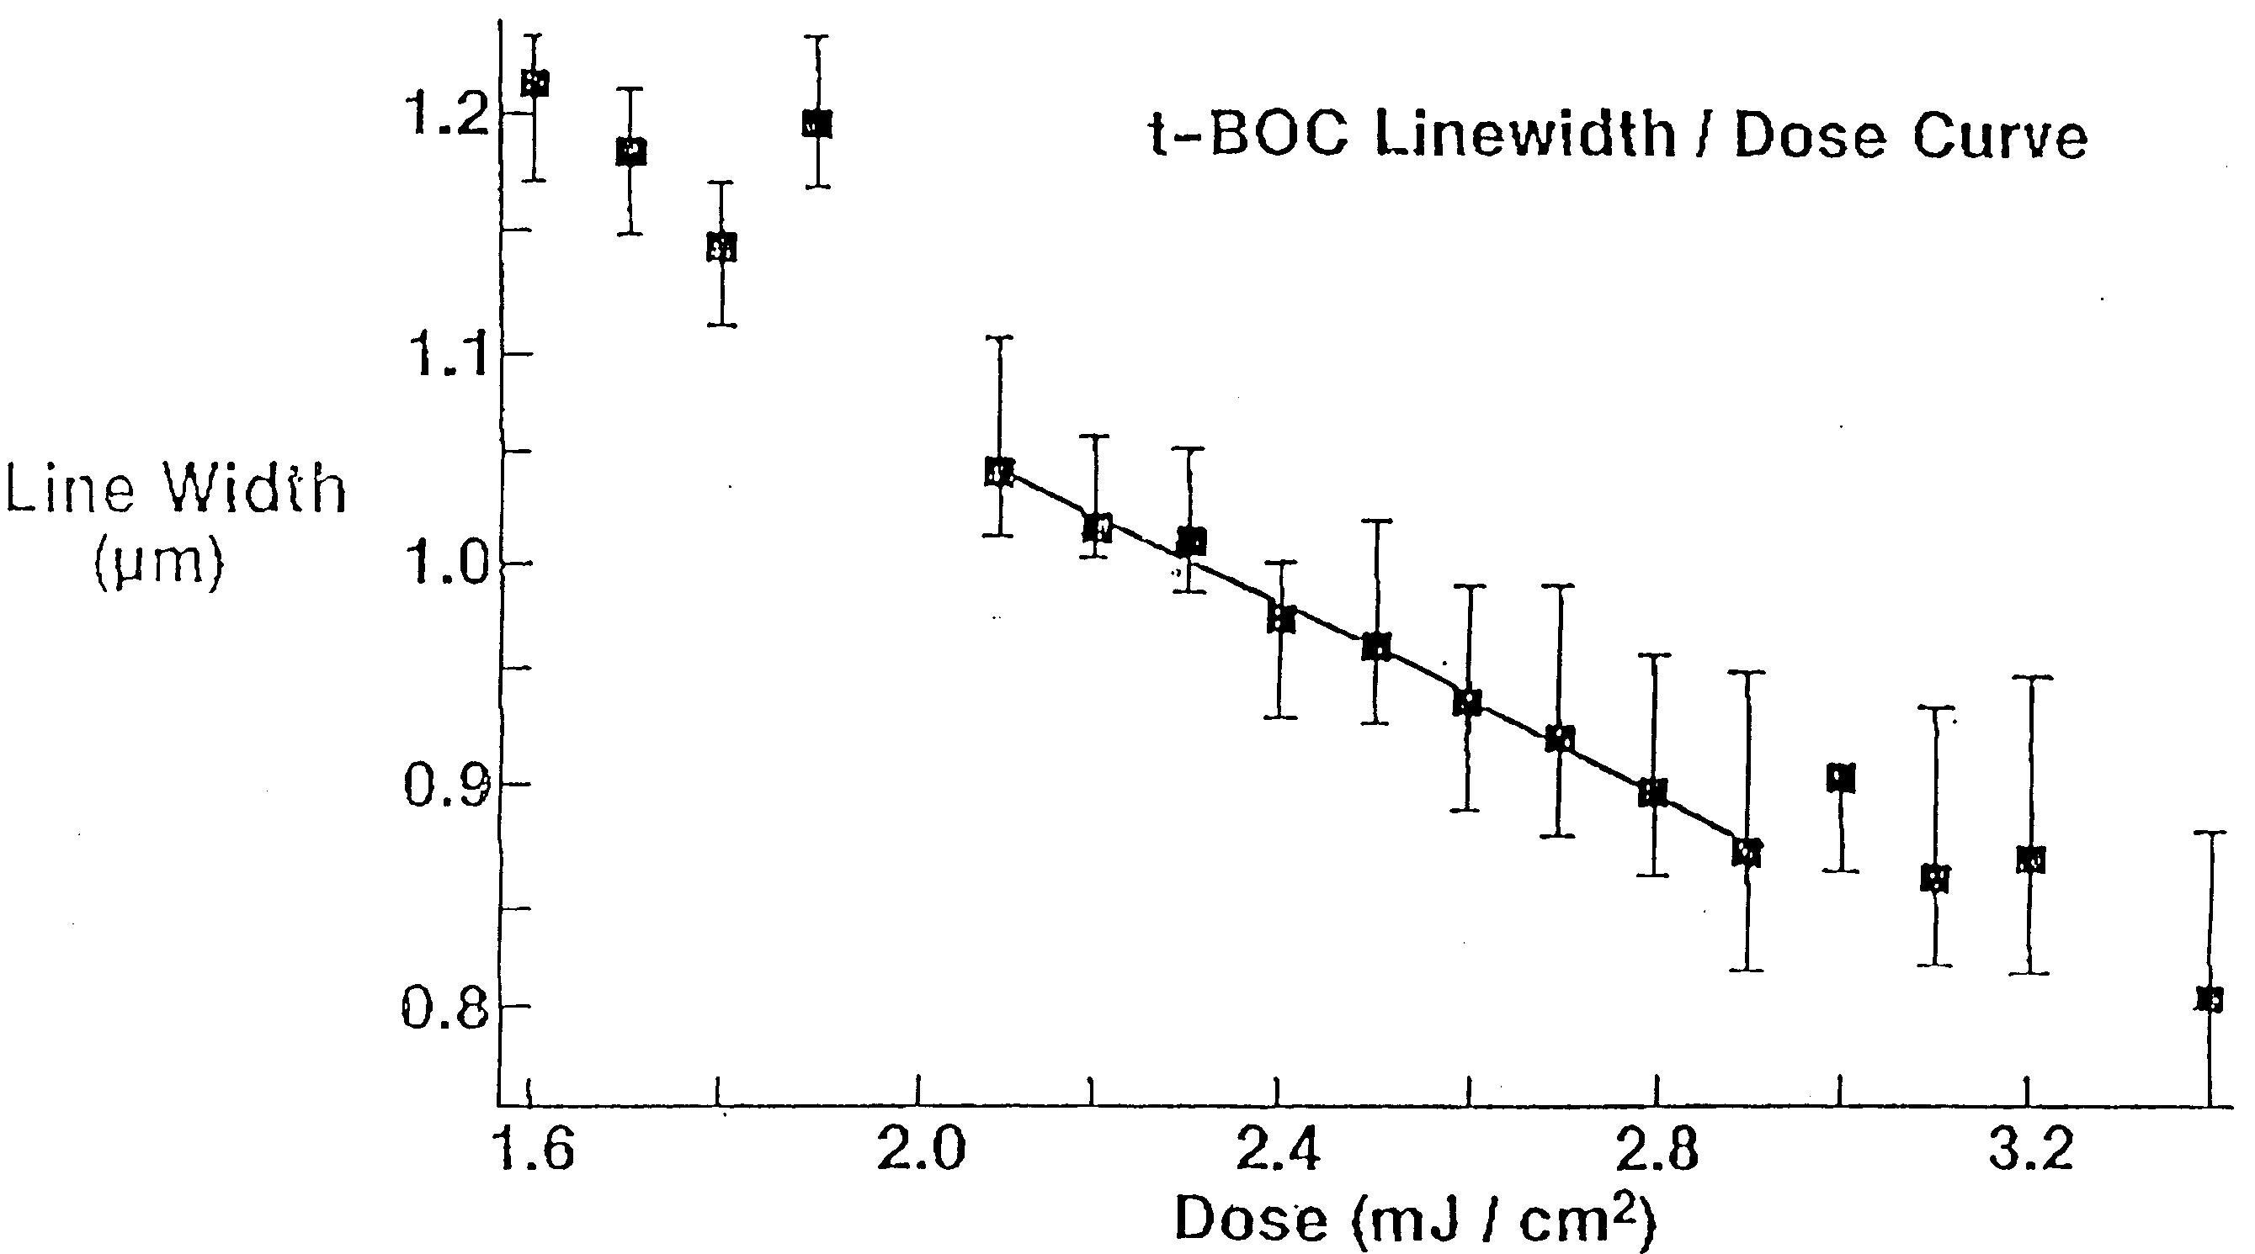
T-BOC line-width dose response
Negative tone development

Slide 23
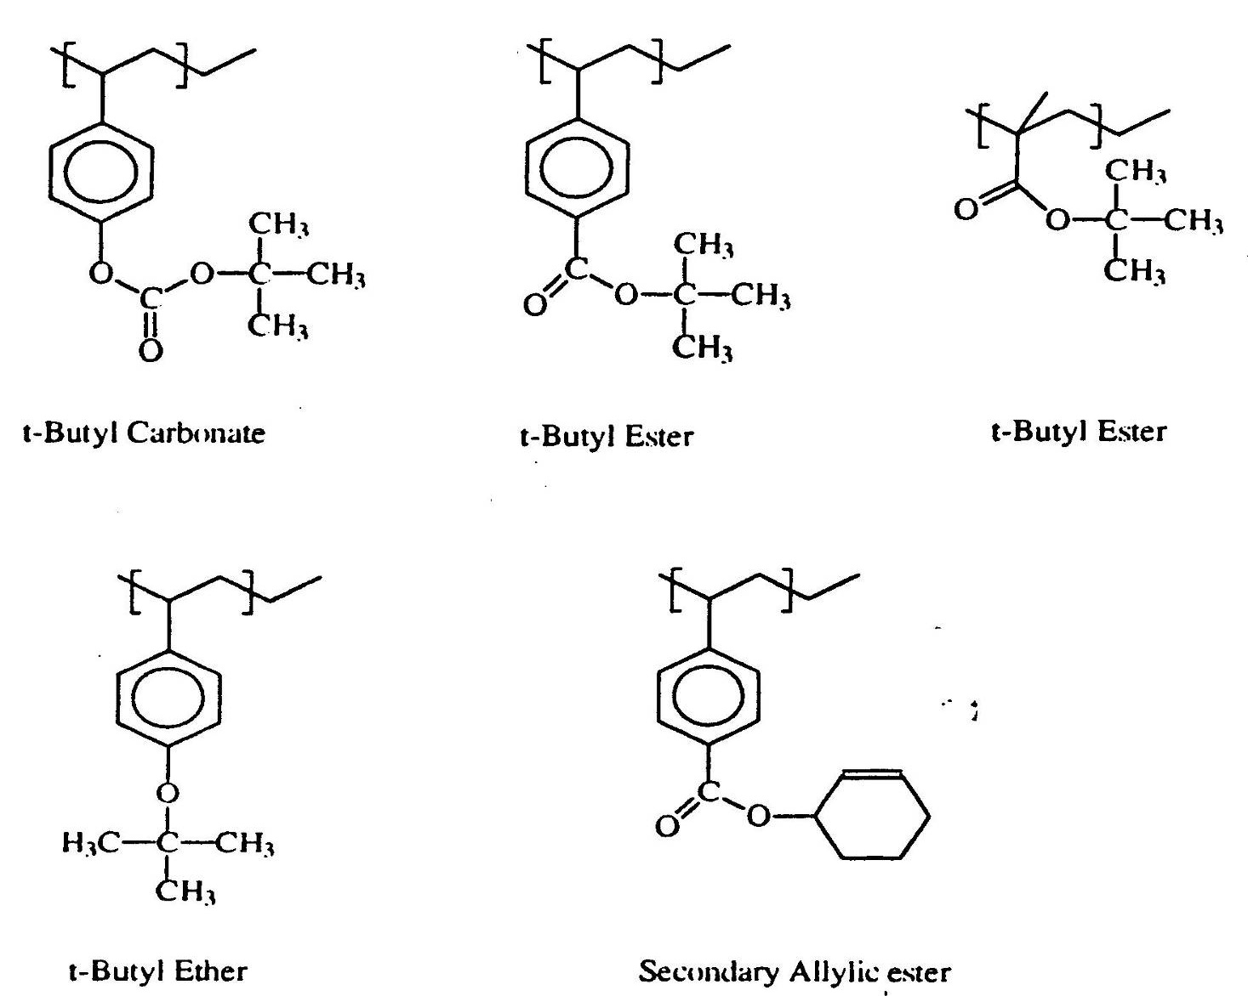
sample structures

Slide 24
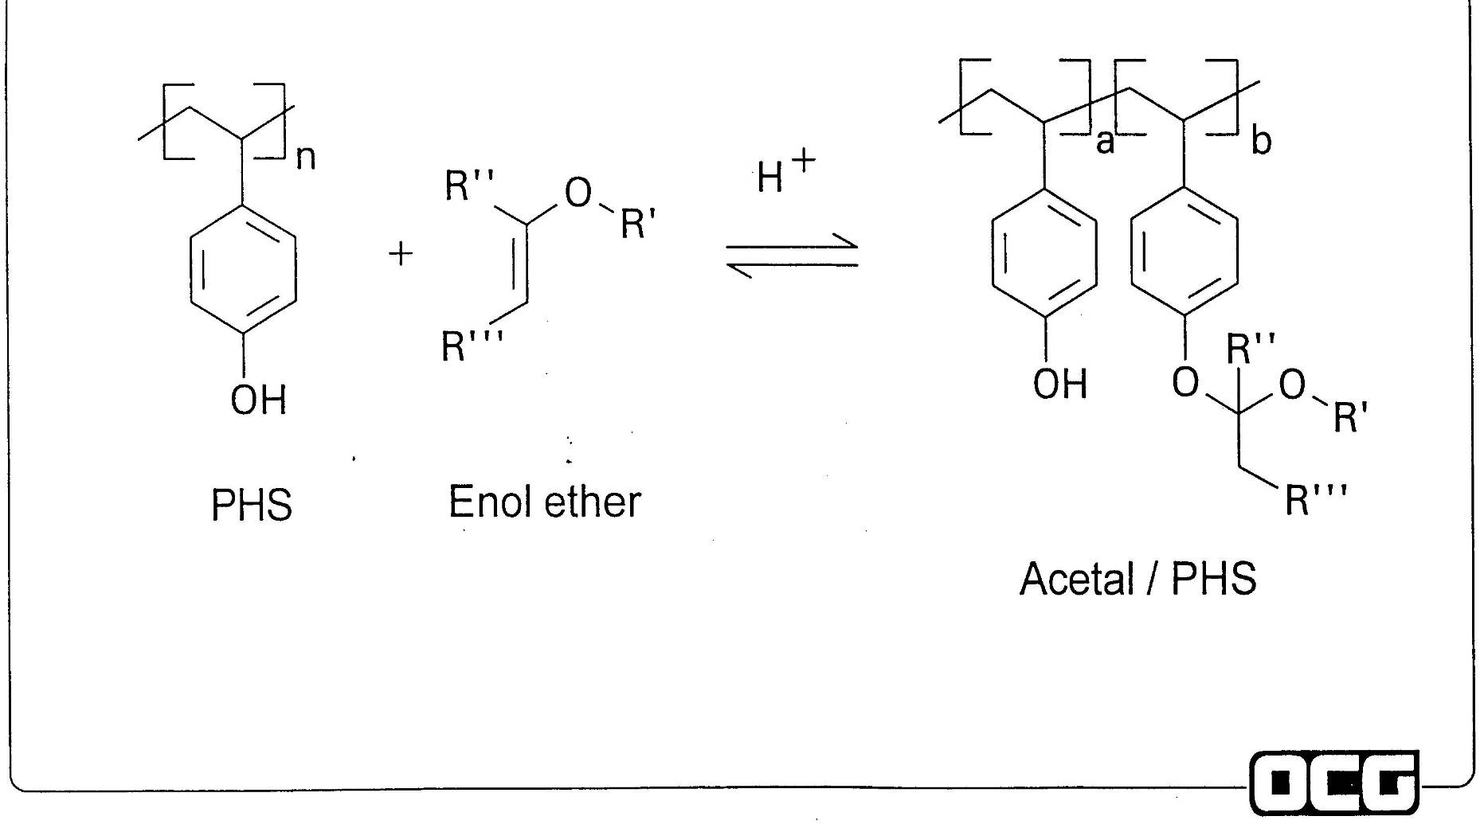
Another approach

Slide 25
High And Low Activation Energy Protective Groups
O
n
n
n
R
O
N
O
O
O
O
H
O
O
H
O
O
R
R
low E_{a}
'
O
O
acetal
R’
t-butyl
ester/ether,
sec. alkyl
C
H
3
O
n
n
n
O
O
H
high E_{a}

Slide 26
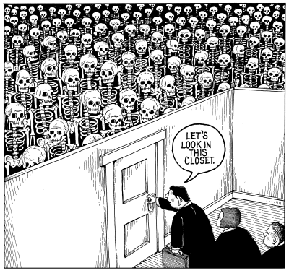
The Skeleton in the Closet

Slide 27
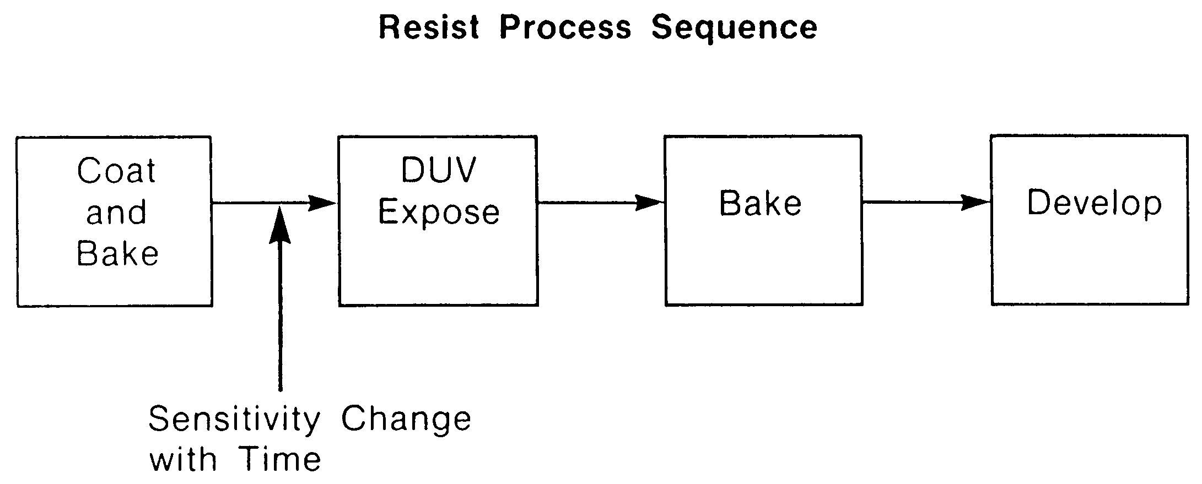

Slide 28
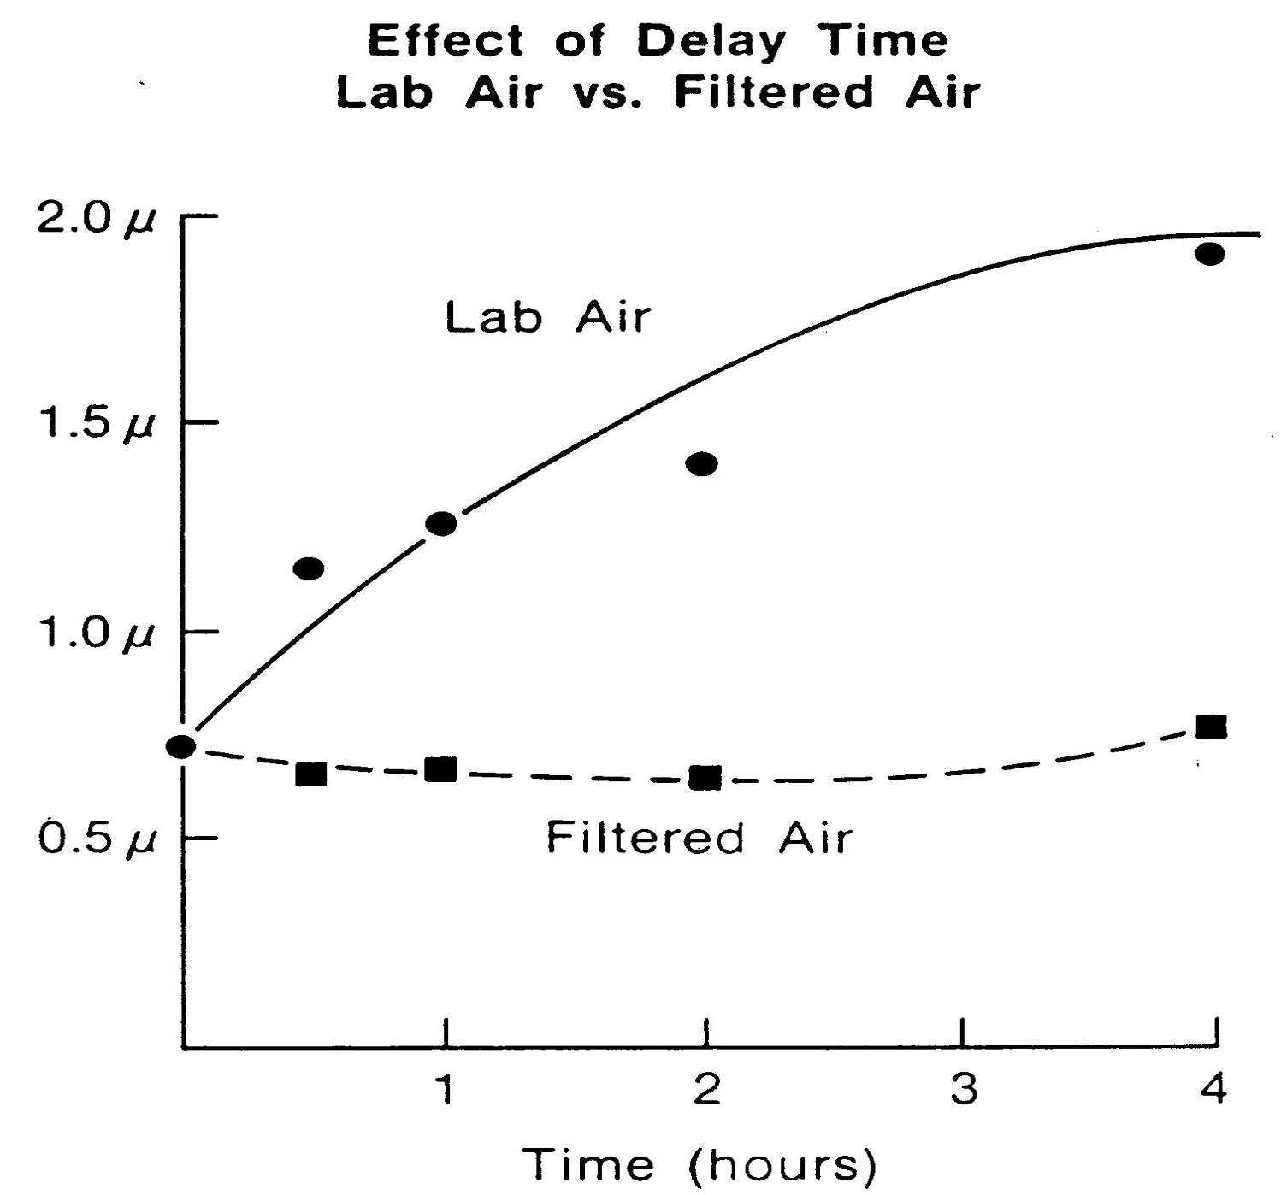

Slide 29
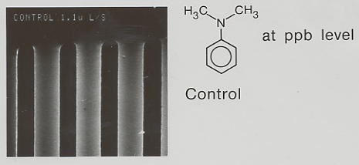

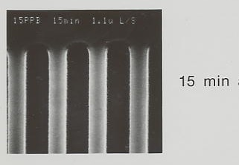
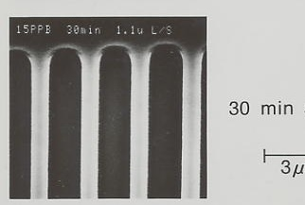
15 ppb of N,N-dimethylaniline
t-BOC Resist in negative tone
- anisole developer

Slide 30
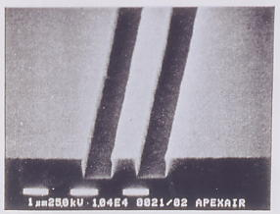
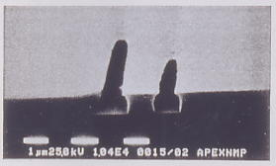
“T” tops
NMP
15 min in filtered air
15 min in 10ppb
NMP before exposure

Slide 31
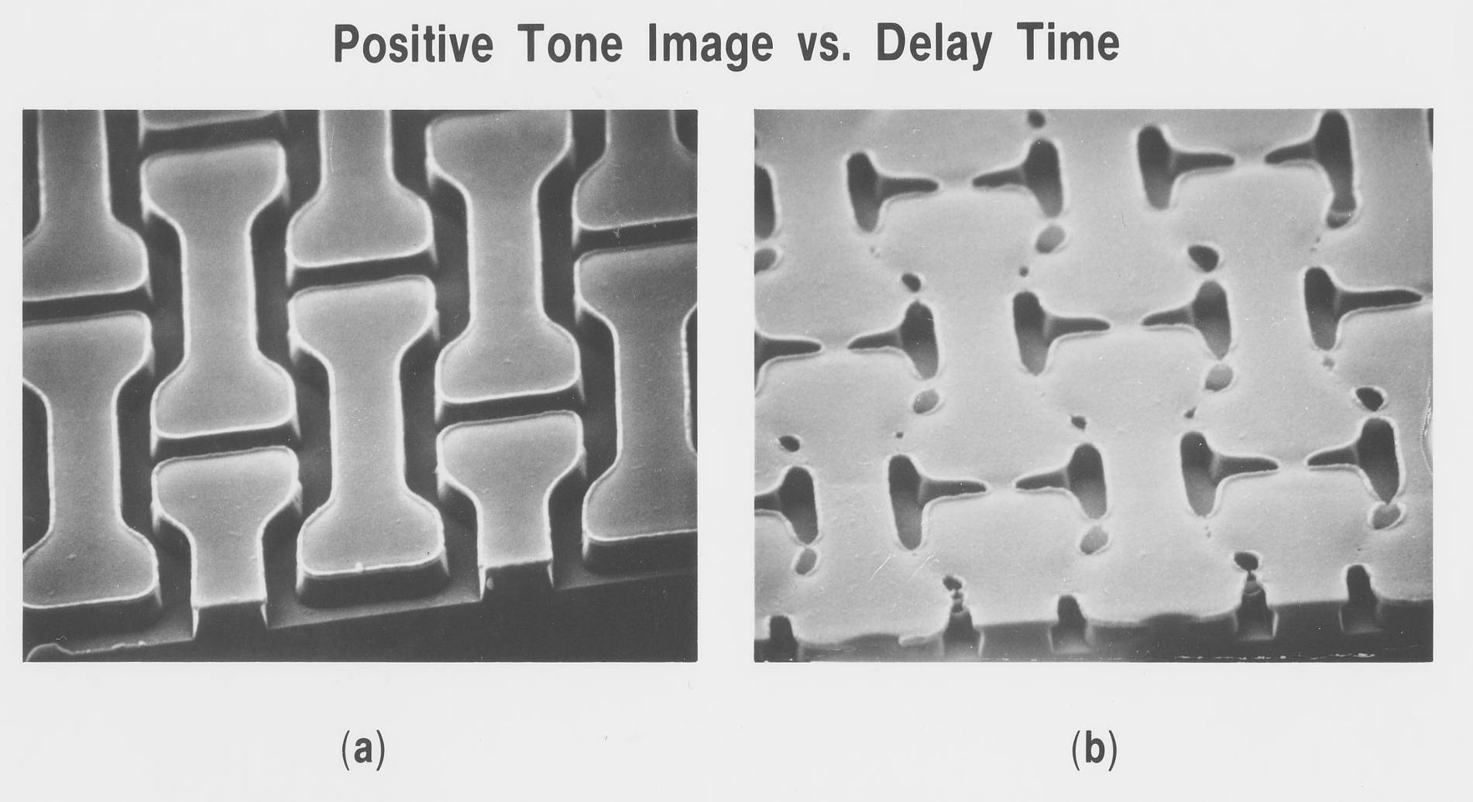
No Delay Post Coating Delay

Slide 32
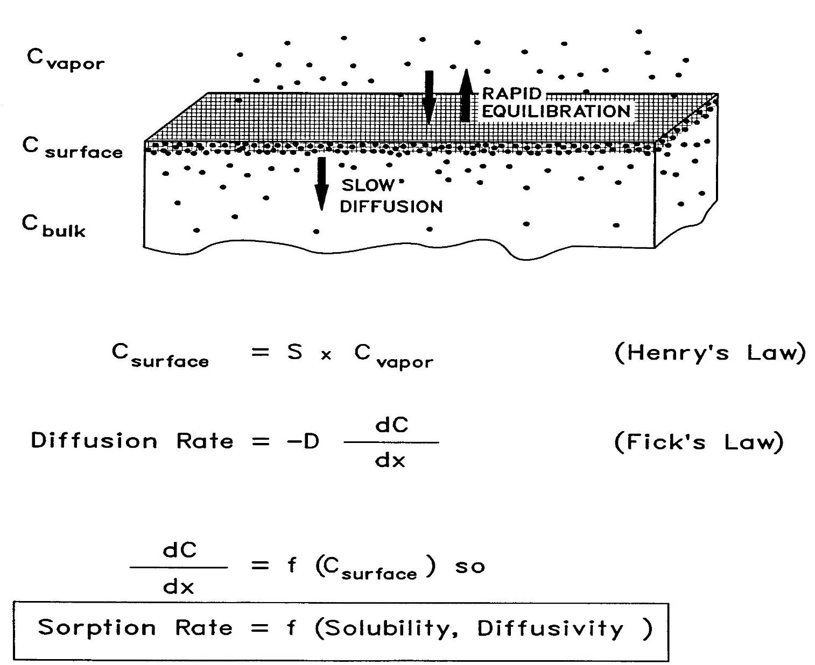
Polymer Permeability
W. Hinsberg, IBM

Slide 33
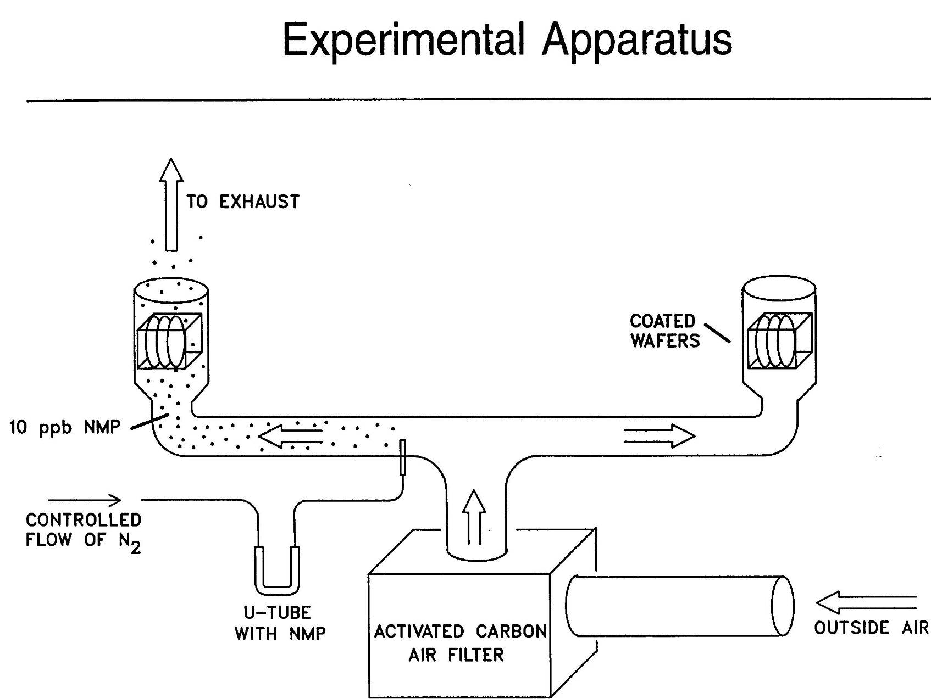
W.D. Hinsberg, et.al. IBM, Almaden

Slide 34
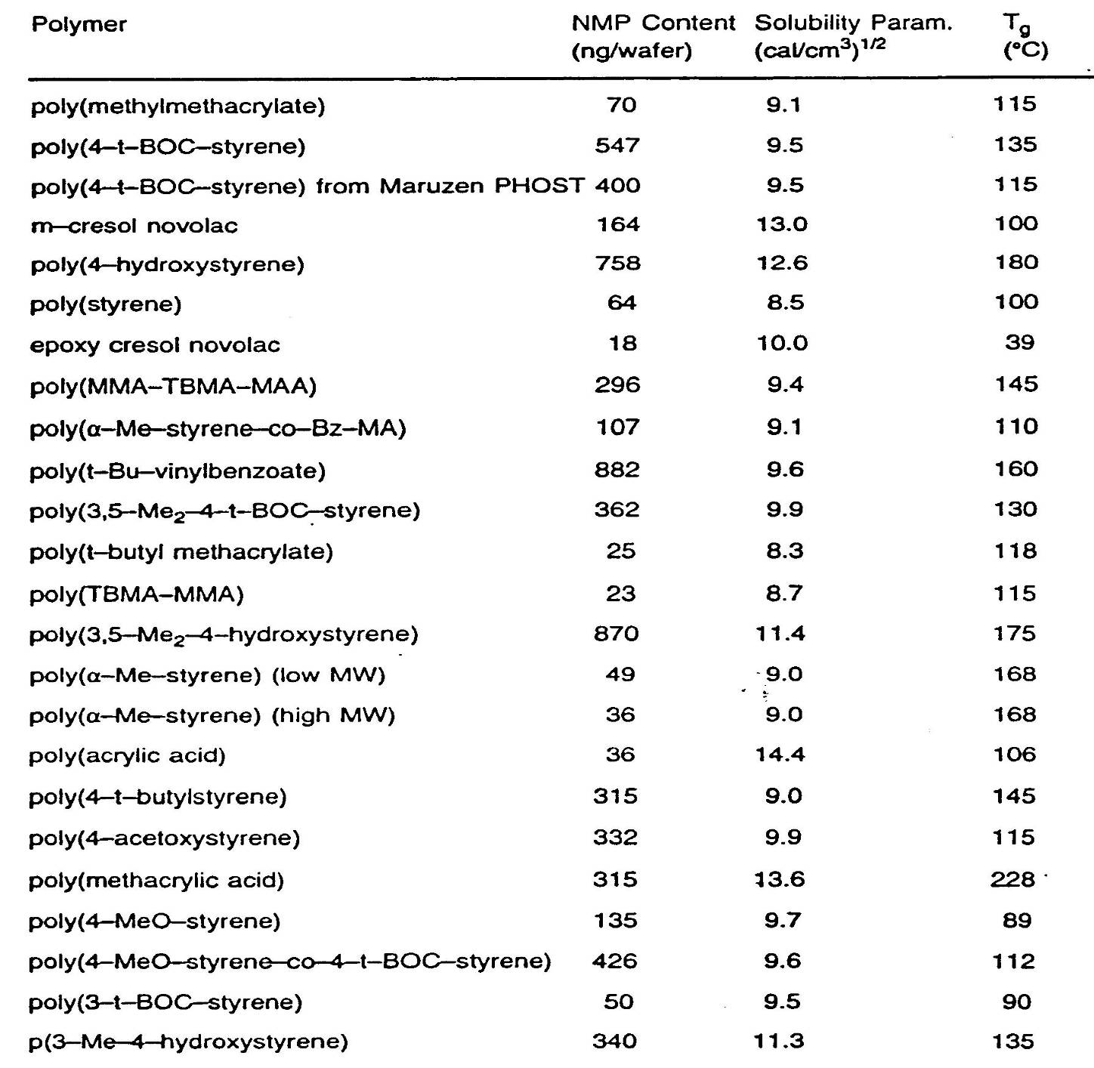

Slide 35
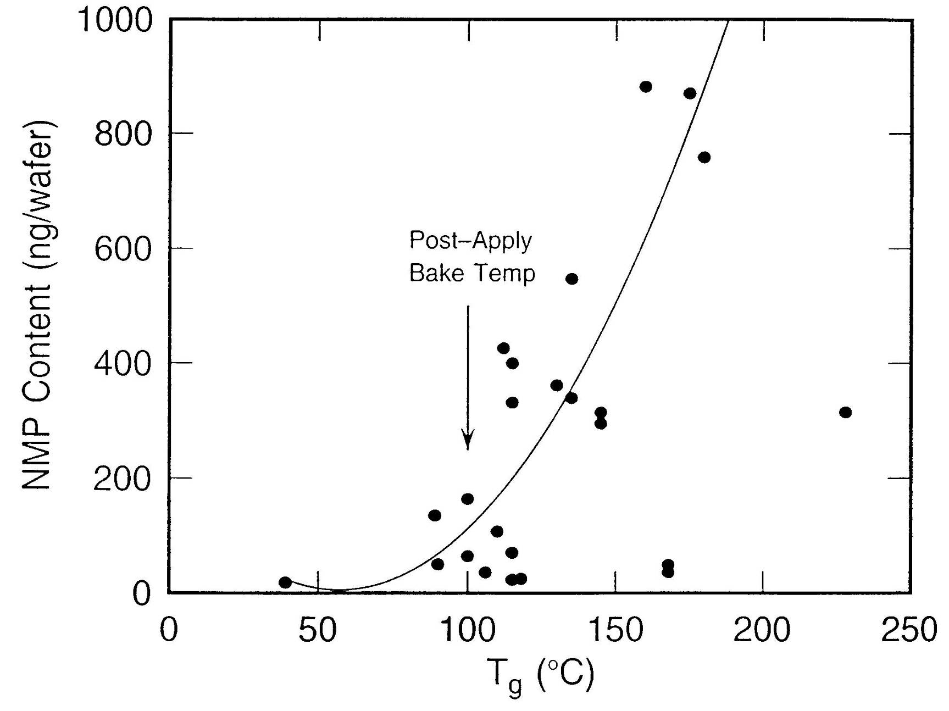

Slide 36
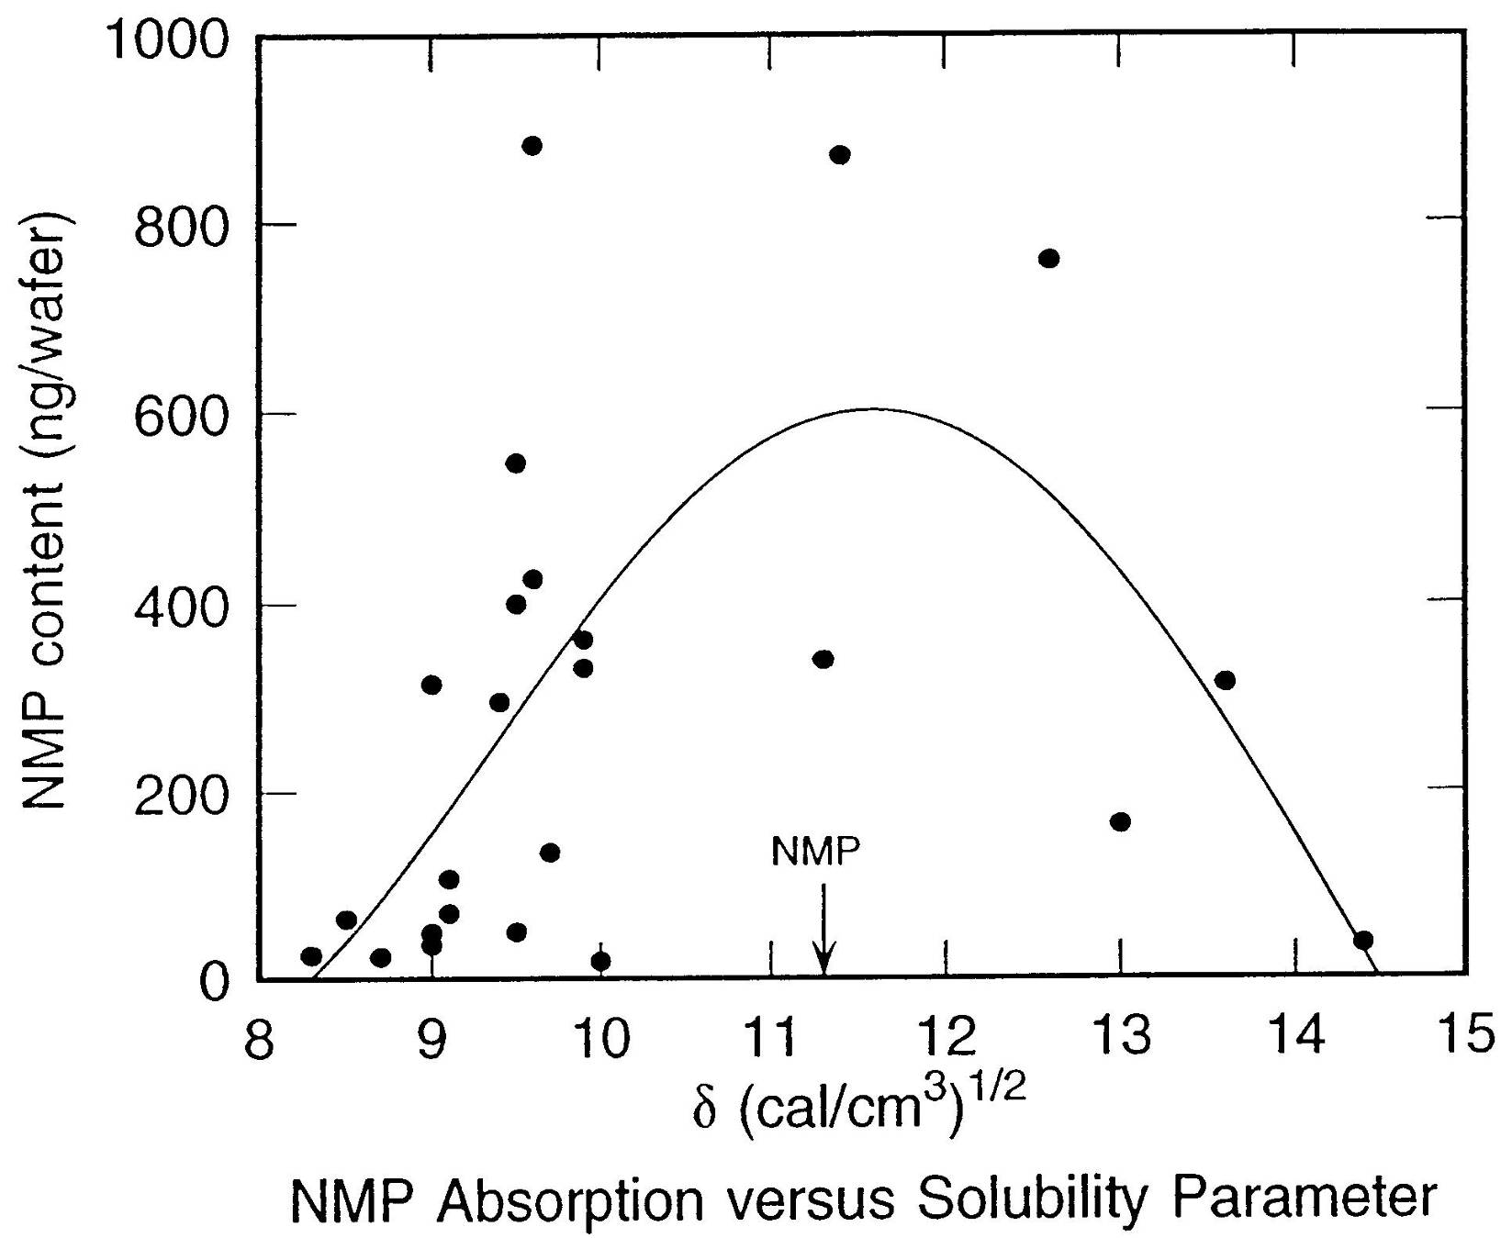

Slide 37
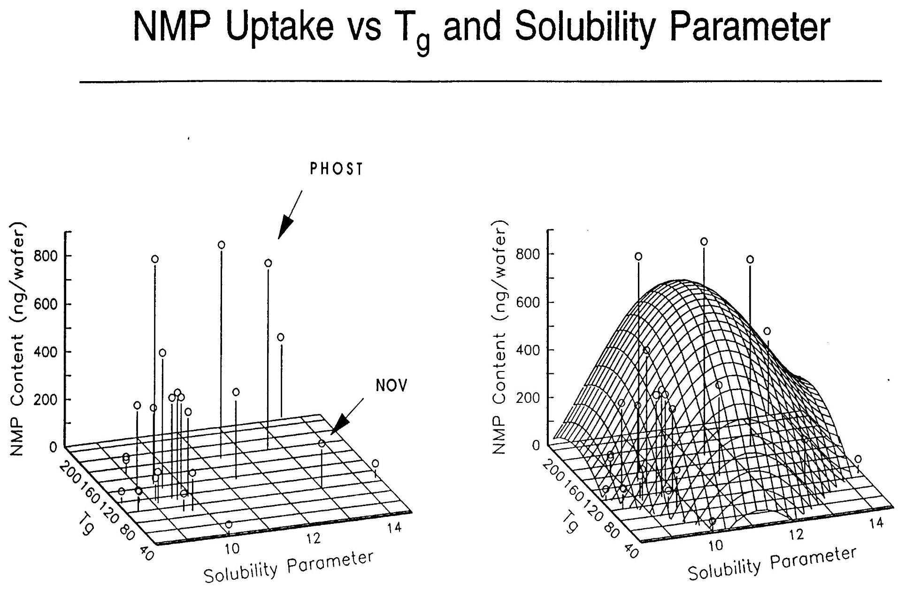

Slide 38
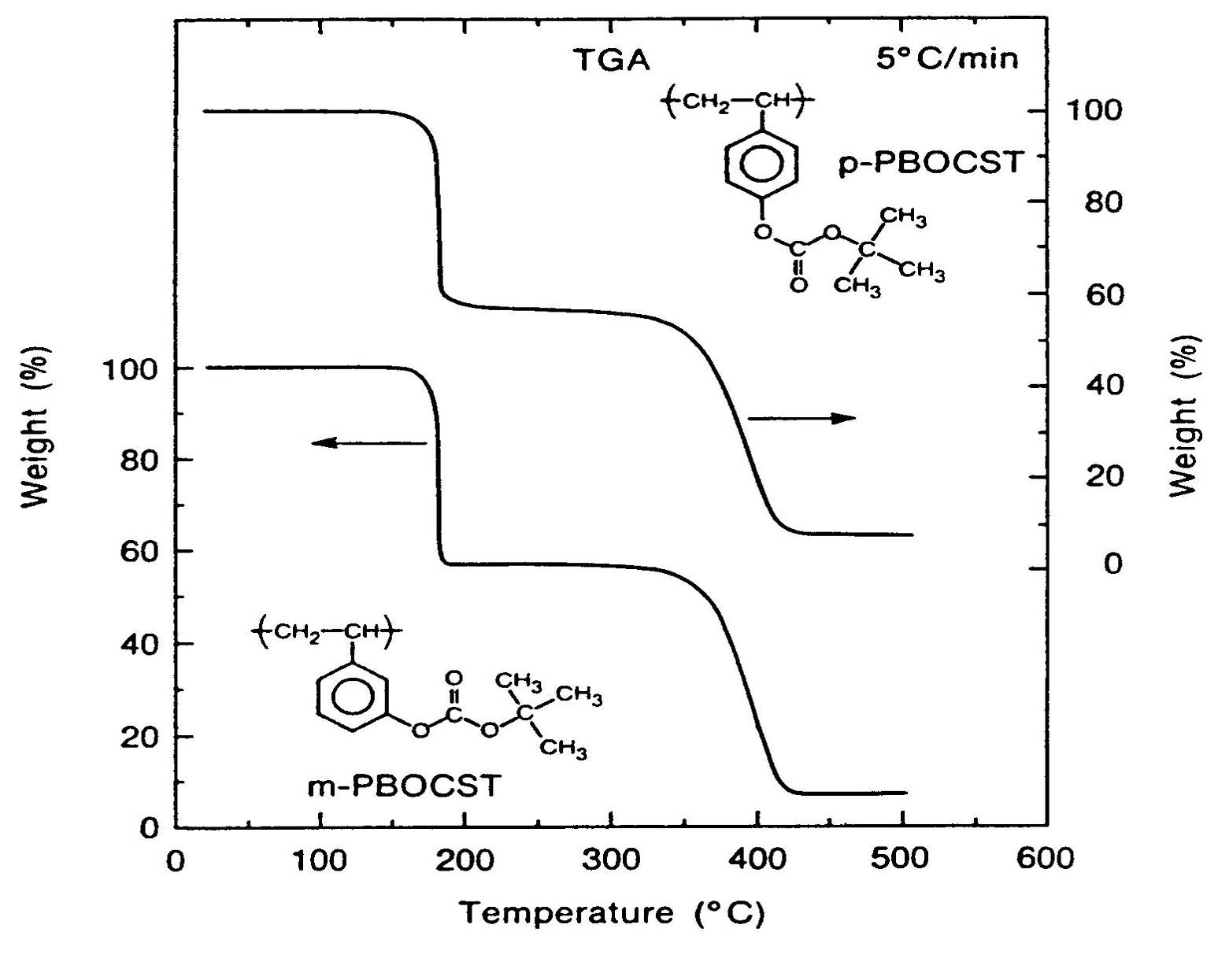
Thermogravimetric analysis
Hiroshi Ito, IBM

Slide 39
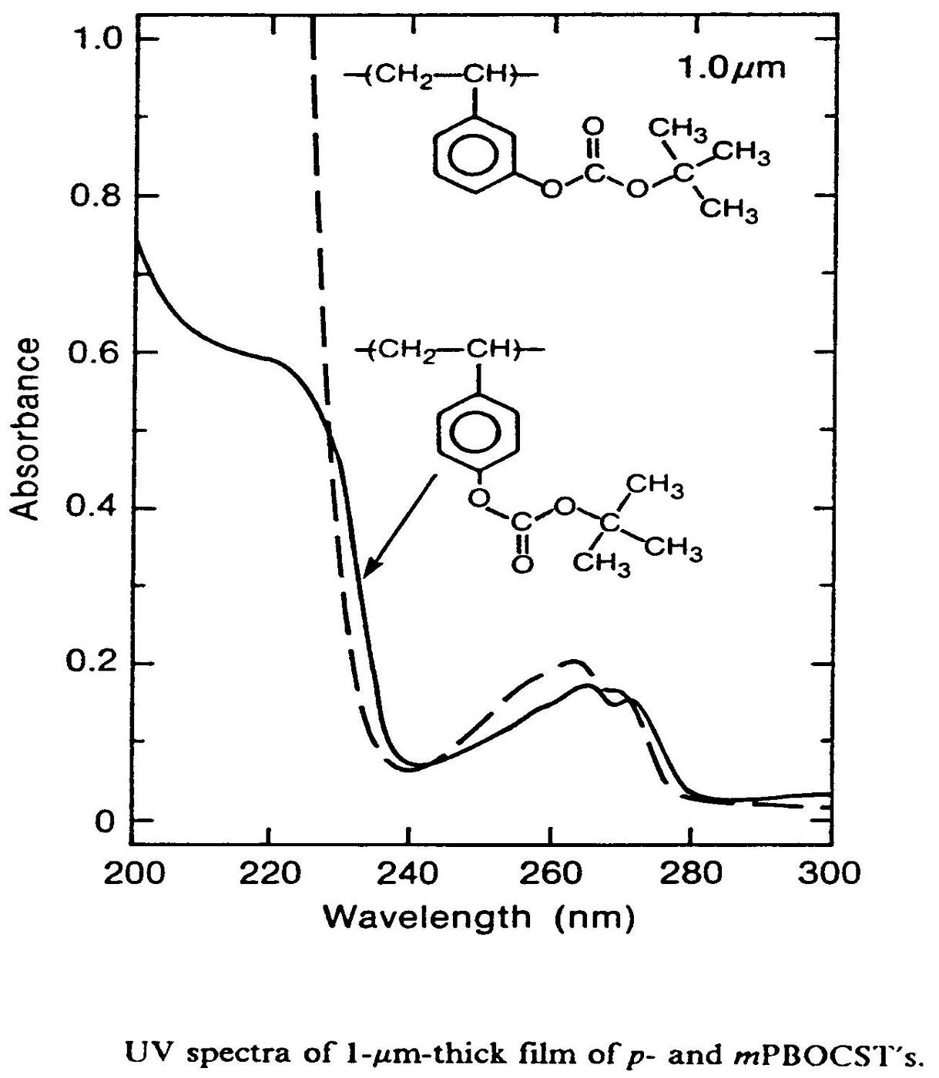

Slide 40
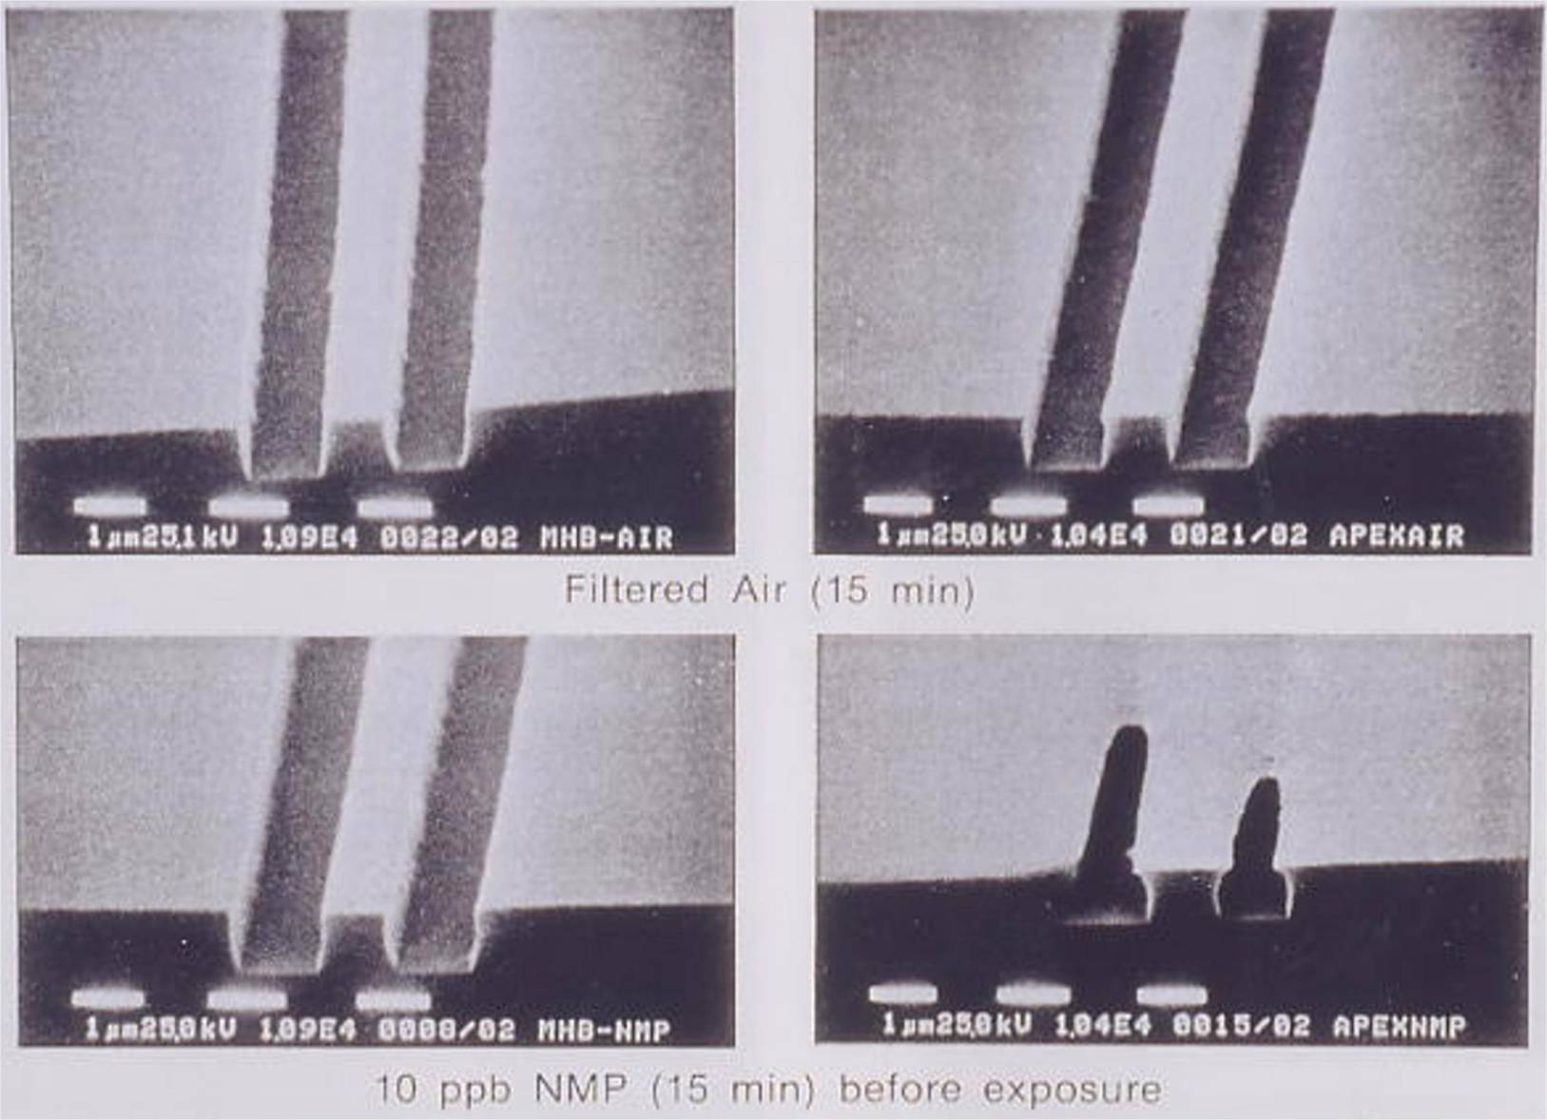
Effects of filtered air (top) and 10ppb NMP (bottom) on positive images printed in the meta- (left) and para- (right) P(HOST-co-BOCST) resists.

Slide 41
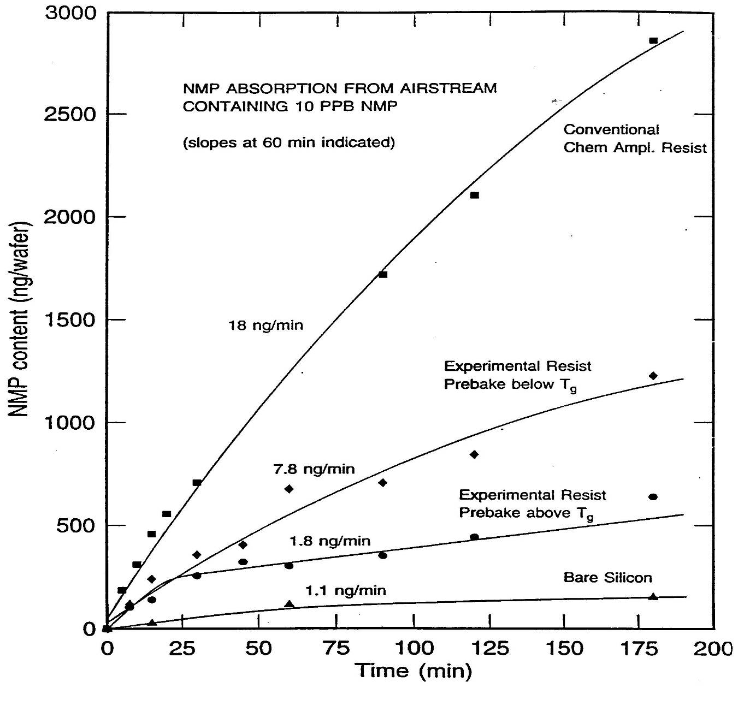

Slide 42
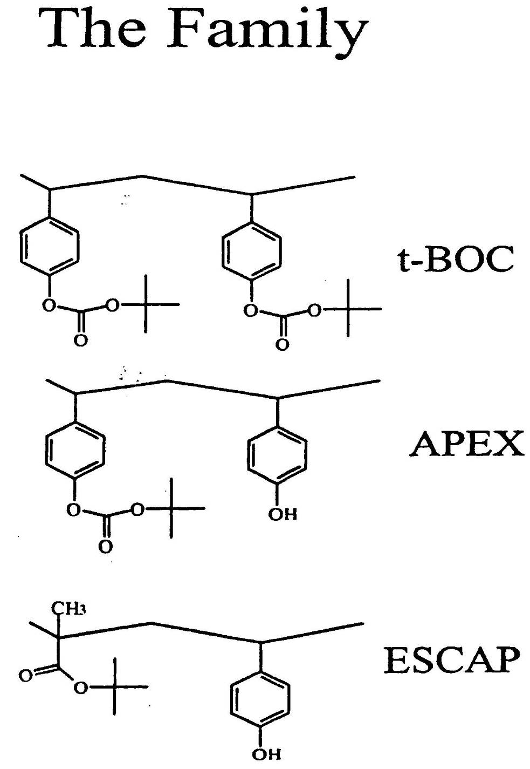
The “Family”

Slide 43
ESCAP
Acrylic reduces solubility of NMP
Acrylic ester more thermally stable than the t-butyl carbonate
Enables post apply bake Temp > Tg
Bake > Tg decreases permeance
Hiroshi Ito, IBM

Slide 44

IBM Mainframe Circuit Board
one of 20 layers printed circuit board that contained nearly a mile of wire interconnections used in IBM Mainframes.

Slide 45
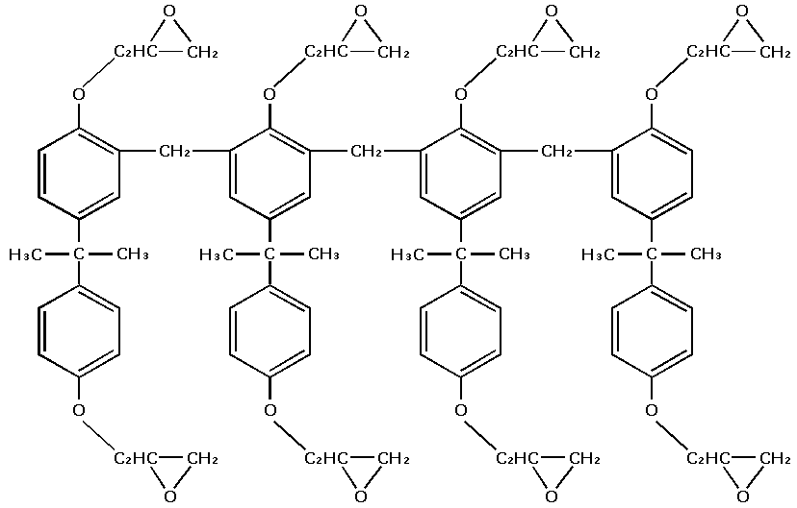
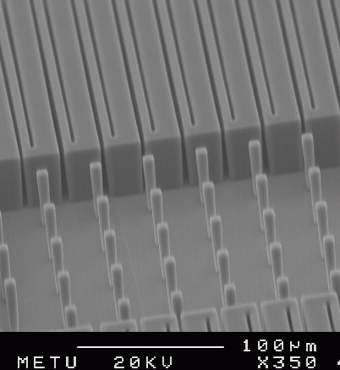
SU-8 Negative Resist

Slide 46
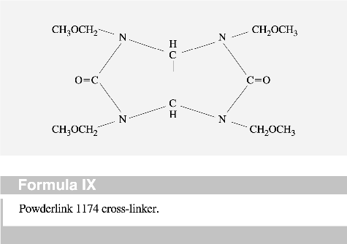
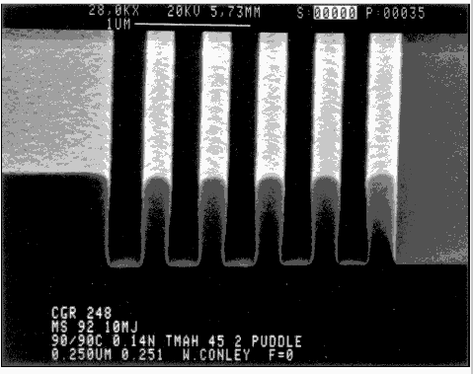
IBM CGR Negative Resist
PAG

Slide 47
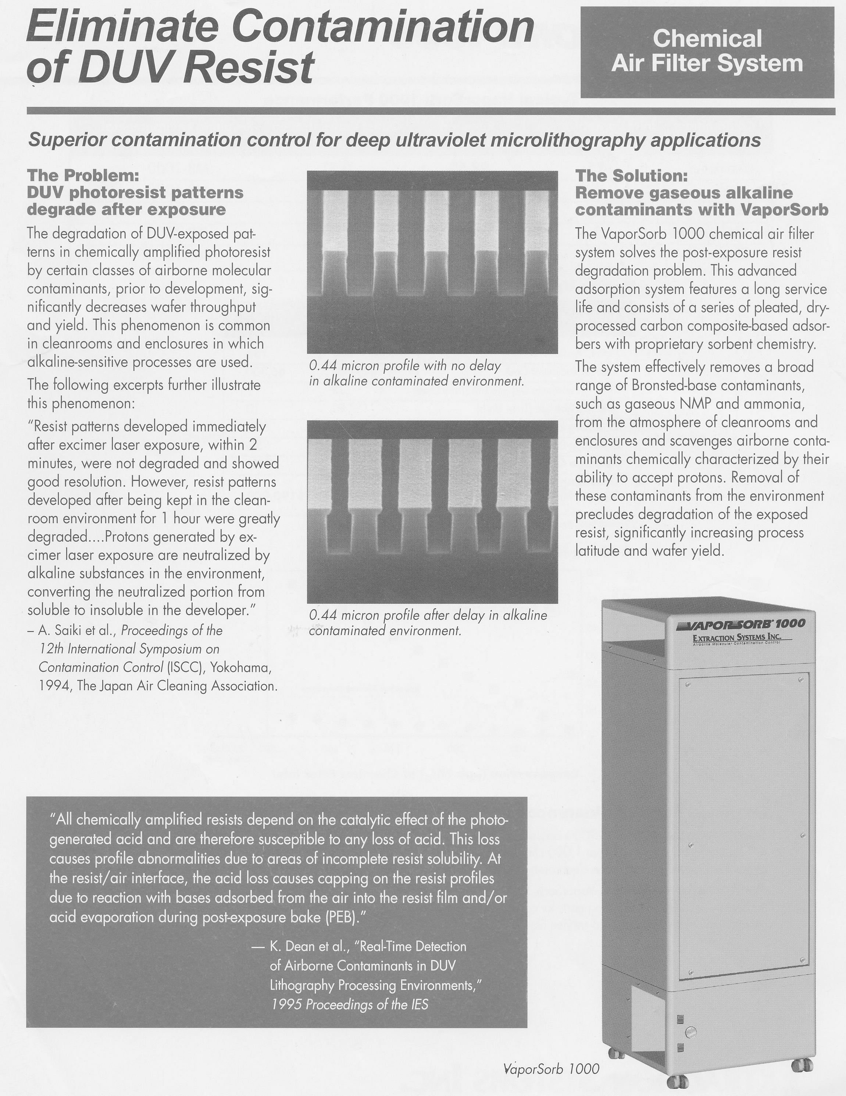
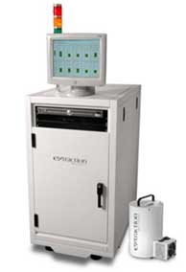
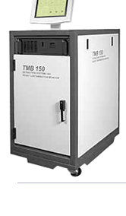

Slide 48
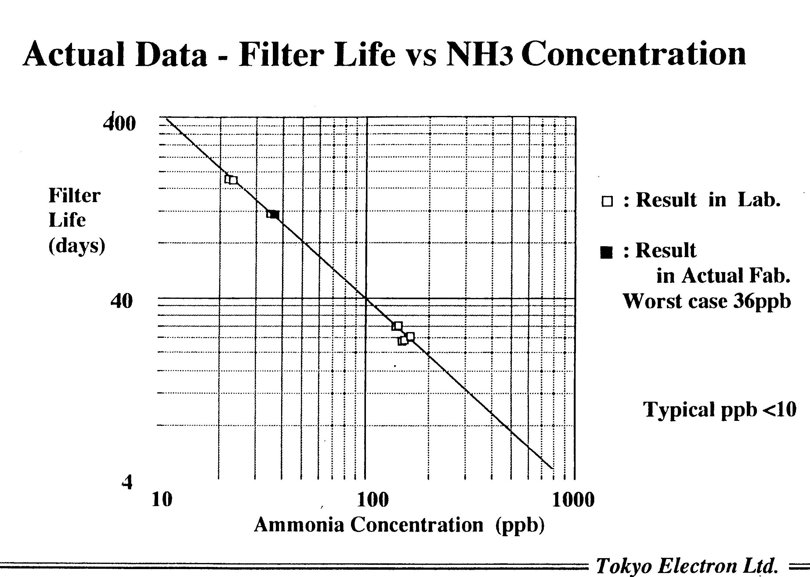

Slide 49
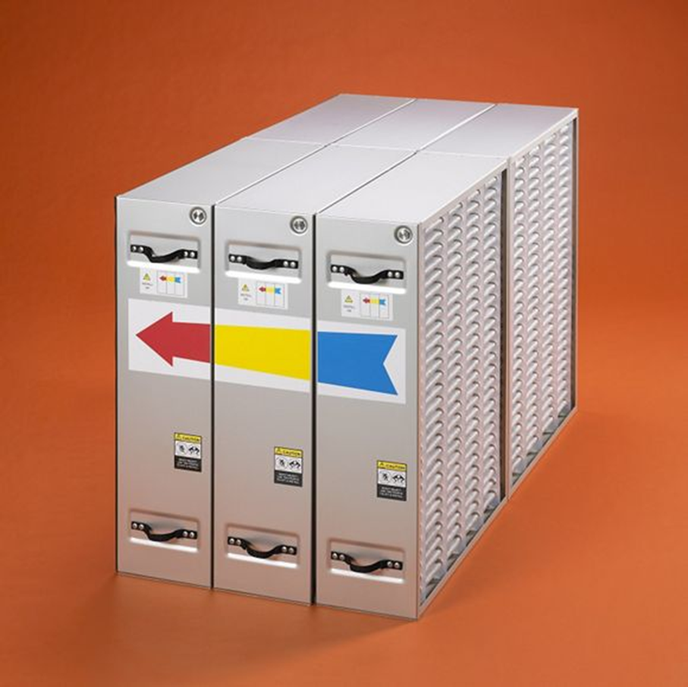
Entergris, Inc
Air purification system

